Slide 1


CS214 – Data Structures
Lecture 14: Trees II
Slides by
Mohamed El-Ramly, PhD
Basheer Youssef, PhD
Notes:
Polls in slides:
in lecture 1: 24,29,31,32,42,46
in lecture 2: 65,84,102,103,108,117,130

Slide 2
Agenda
  Introduction to Binary Trees
  Implementing Binary Trees
  Searching Binary Search Trees
  Tree Traversal …1. Breadth-First ….2. Depth-First
  Insertion
  ……2. By Copying
  ……2. AVL Trees
  .
  Heaps / Heap Sort
  .

Slide 3
6.4 Tree Traversal
Tree traversal is the process of visiting each node in the tree once. It is like linearizing the tree.
How many ways are there for traversing a tree with n nodes?

Slide 4
Chapter 6: Binary Trees

Slide 5
Chapter 6: Binary Trees

Slide 6
Breadth-First Traversal
Breadth-First Traversal is visiting all the nodes at one level first before moving to the next level.
When would you want to use this kind of traversal?
Can you give an example?
How can it be implemented using a queue?

Slide 7
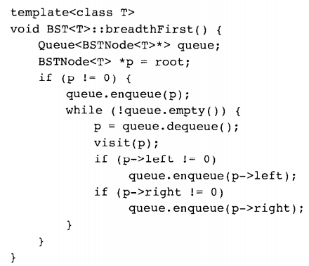
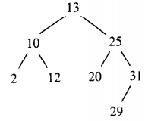
Breadth-First Traversal
13 10 25 2 12 20 31 29

Slide 8

Chapter 6: Binary Trees

Slide 9
Depth-First Traversal
Depth-First Traversal is visiting all the nodes by going as deep as possible and then backtracking by moving one level up and then going as deep as possible, etc.
When would we need it?
  Solving Mazes
  . . . .
There are three types of Depth-First Traversal:
  Inorder: LVR
  Preorder: VLR
  Postorder: LRV

Slide 10
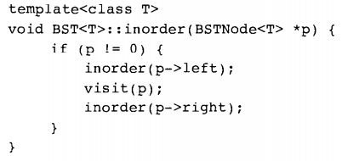
Inorder Traversal
2 10 12 13 20 25 29 31

Slide 11
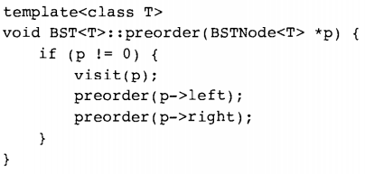
Preorder Traversal
13 10 2 12 25 20 31 29

Slide 12
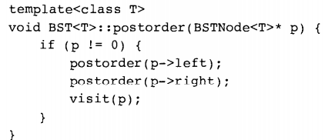
Postorder Traversal
2 12 10 20 29 31 25 13

Slide 13
Chapter 6: Binary Trees

Slide 14
Depth-First Traversal
Depth-First Traversal uses recursion to yield elegant simple algorithms.
But it puts a big burden on the stack if the tree is huge.
Other implementations that are not stack-based exits.

Slide 15
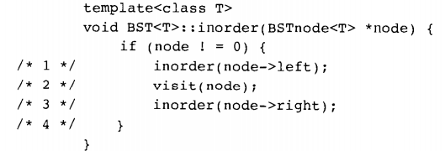
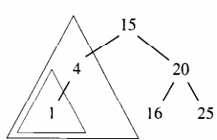
Assume This Tree and Algo.

Slide 16
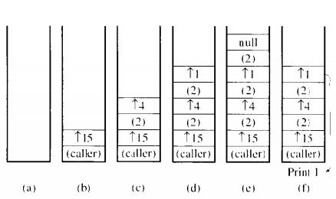
Then Runtime Stack is …

Slide 17
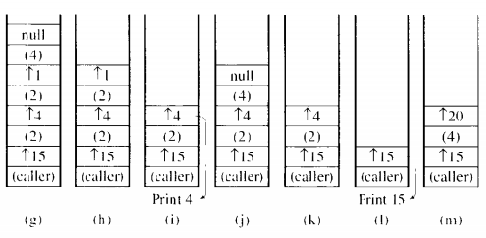
Then Runtime Stack is …

Slide 18
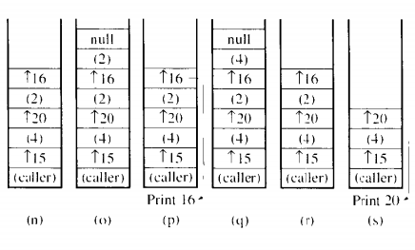
Then Runtime Stack is …

Slide 19
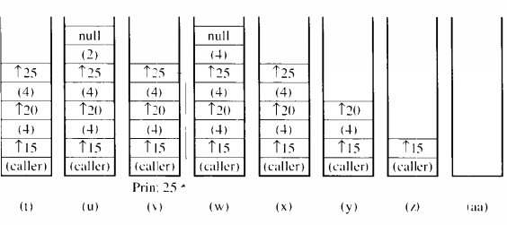
Then Runtime Stack is …

Slide 20
Chapter 6: Binary Trees

Slide 21
6.5 Insertion in BST
Insertion is similar to searching a BST, except that when we do not find the desired element, we insert the new element at the dead end where we stopped.
Example, insert jill in the given tree.
Note: Ignore threaded trees

Slide 22
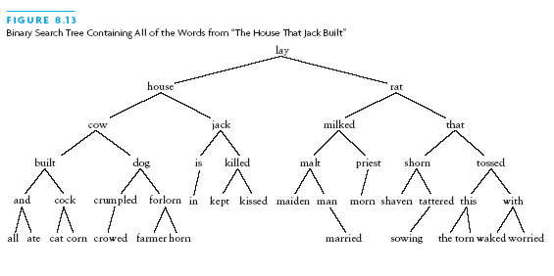
6.5 Insertion in BST

Slide 23
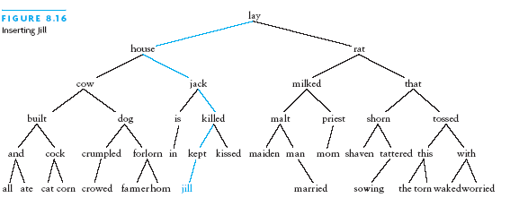
6.5 Insertion in BST

Slide 24
Chapter 6: Binary Trees

Slide 25
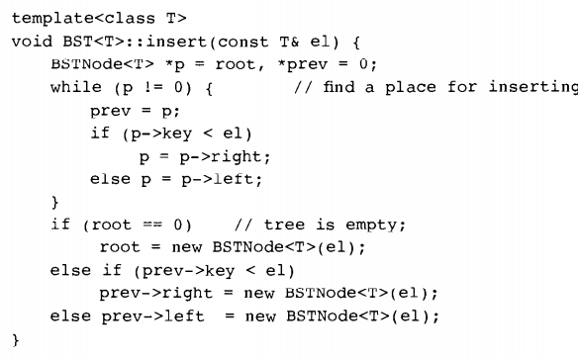
6.5 Insertion in BST

